Slide 1
Security in Computing, 4th Ed, Pfleeger
Chapter 3
Program Security
Notes:
The University of Adelaide, School of Computer Science
Chapter 2 — Instructions: Language of the Computer

Slide 2
In this chapter
Programming errors with security implications
  buffer overflows, incomplete access control
Malicious code
  viruses, worms, Trojan horses
Program development controls against malicious code and vulnerabilities
  software engineering principles and practices
Controls to protect against program flaws in execution
  operating system support and administrative controls

Slide 3
Programs Security
Protecting programs is at the heart of computer security
  programs constitute so much of a computing system (the operating system, device drivers, the network infrastructure, database management systems and other applications, even executable commands on web pages); all are called “programs”
So we need to ask two important questions:
  How do we keep programs free from flaws?
  How do we protect computing resources against programs that contain flaws?

Slide 4
Secure Programs
What we mean when we say that a program is "secure."
  security implies some degree of trust that the program enforces expected confidentiality, integrity, and availability.
From the point of view of a program or a programmer, how can we look at a software component or code fragment and assess its security?
  similar to the problem of assessing software quality in general

Slide 5
Secure Programs
One way to assess security or quality is to ask people to name the characteristics of software that contribute to its overall security
  different answers from different people because the importance of the characteristics depends on who is analyzing the software
    one person may decide that code is secure because it takes too long to break through its security controls
    someone else may decide code is secure if it has run for a period of time with no apparent failures
    a third person may decide that any potential fault in meeting security requirements makes code insecure

Slide 6
Secure Programs
An assessment of security can also be influenced by someone's general perspective on software quality
  if your manager's idea of quality is conformance to specifications, then she might consider the code secure if it meets security requirements, whether or not the requirements are complete or correct.
  This security view played a role when a major computer manufacturer delivered all its machines with keyed locks
    since a keyed lock was written in the requirements
    But the machines were not secure, because all locks were configured to use the same key
  Thus, another view of security is fitness for purpose
    in this view, the manufacturer (mentioned above) clearly had room for improvement

Slide 7
Secure Programs
In general, practitioners often look at quantity and types of faults for evidence of a product's quality (or lack of it)
  developers track the number of faults found in requirements, design, and code inspections and use them as indicators of the likely quality of the final product

Slide 8
Fixing Faults
You might argue that a module in which 100 faults were discovered and fixed is better than another in which only 20 faults were discovered and fixed
  more rigorous analysis and testing had led to the finding of the larger number of faults

Slide 9
Fixing Faults
Early work in computer security was based on the paradigm of "penetrate and patch,"
  analysts searched for and repaired faults
  test a system's security by attempting to cause it to fail
  The test was considered to be a "proof" of security
    if the system withstood the attacks, it was considered secure
    Unfortunately, the proof became a counterexample
  The problem discovery in turn led to a rapid effort to "patch" the system to repair or restore the security
    However, the patch efforts were largely useless, making the system less secure rather than more secure because they frequently introduced new faults

Slide 10
Read about Fuzz Testing

Slide 11
Unexpected Behavior
A better approach than "penetrate and patch," is to compare the requirements with the behavior
  Test whether programs behave as their designers intended or users expected
    unexpected behavior is a program security flaw
    Program security flaws can derive from any kind of software fault
      They range from a misunderstanding of program requirements to a one-character error in coding or even typing
    two separate logical categories of program flaws :
      Inadvertent/unintentional human errors
      malicious, intentionally induced flaws.
    we still have to address the flaws’ effects, regardless of intention.
      "it doesn't matter whether the stone hits the pitcher or the pitcher hits the stone, it's going to be bad for the pitcher."

Slide 12
Security Flaws
A system attack often exploits an unintentional security flaw to perform intentional damage
Regrettably, we do not have techniques to eliminate or address all program security flaws
  security is fundamentally hard and conflicts with usefulness and performance
  Two reasons for this distressing situation
    To test a program functionality we test against the “should do” checklist NOT the “should not do” one. It is almost impossible to ensure that a program does precisely what its designer or user intended, and nothing more.
    Programming and software engineering techniques change and evolve far more rapidly than do computer security techniques
      So we often find ourselves trying to secure last year's technology while software developers are rapidly adopting today's and next year's technology.

Slide 13
Types of Flaws
A list of categories that helps distinguishing one kind of problem from another and gives us a useful overview of the ways in which programs can fail to meet their security requirements
  Validation error (incomplete or inconsistent): permission checks
    occur when a program fails to check that the parameters supplied or returned to it conform to its assumptions about them, or when these checks are misplaced
  Domain error: controlled access to data
    occur when the intended boundaries between protection environments are porous including implicit sharing of privileged/confidential data or when then the lower level representation of an abstract object, supposed to be hidden in the current domain, is in fact exposed

Slide 14
Types of Flaws
Serialization: program flow order
  permit asynchronous behavior of different system components to be exploited (TOCTTOU)
Boundary condition violation: failure on first or last case
  occur due to omission of checks to assure that constraints (table size, file allocation, or other resource consumption) are not exceeded
Inadequate identification and authentication: basis for authorization
  permits operations to be invoked without sufficiently checking the identity and the authority of the invoking entity

Slide 15
Nonmalicious Program Errors
Unintentional mistakes
  cause program malfunctions
  but some lead to more serious security vulnerabilities

Slide 16
Buffer Overflows
It is an example on Boundary condition violation
Definition
  A buffer (or array or string) is a space in which data can be held
  A buffer resides in memory
  Because memory is finite, a buffer's capacity is finite
  in many programming languages the programmer must declare the buffer's maximum size
    Then the compiler can set aside that amount of space

Slide 17
Buffer Overflows
Example
  char sample[10];
  One byte for elements sample[0] through sample[9]
  Now we execute the statement:
    sample[10] = 'B';
  The subscript 10 is out of bounds
    The compiler can detect it during the compilation
    However, if the statement were
      sample[i] = 'B';
      we could not identify the problem until i was set during execution
    The problem's occurrence depends on what is adjacent to the array sample

Slide 18
Buffer Overflows
Example
  suppose each of the ten elements of the array sample is filled with the letter A and the erroneous reference uses the letter B, as follows:
    for (i=0; i<=9; i++)
      sample[i] = 'A';
      sample[10] = 'B'

Slide 19
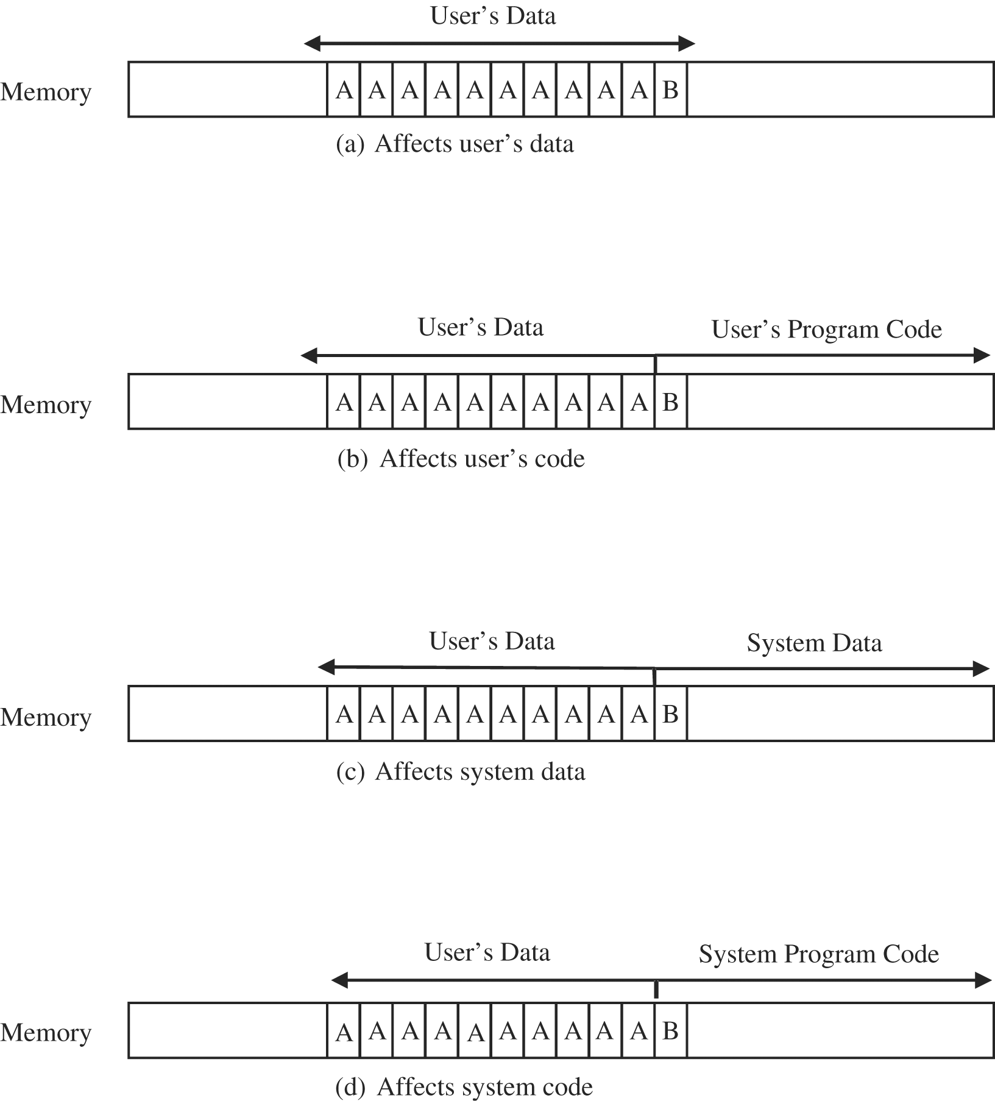
Buffer Overflows (Example Cont.)
  So there are four cases to consider in deciding where the 'B' goes

Slide 20
Buffer Overflows (Example Cont.)
If the extra character overflows into the user's data space
  it simply overwrites an existing variable value
    perhaps affecting the program's result
    but affecting no other program or data
In the second case, the 'B' goes into the user's program area
  If it overlays an already executed instruction
    no effect
  If it overlays an instruction that is not yet executed
    the machine will try to execute an instruction with operation code 0x42
      the internal code for the character 'B‘
Spilling over into system data or code areas produces similar results to those for the user's space: computing with a faulty value or trying to execute an improper operation.

Slide 21
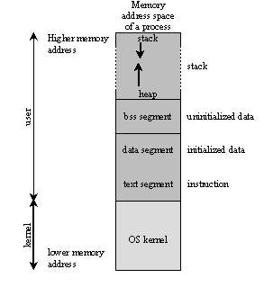
Process Address Space

Slide 22
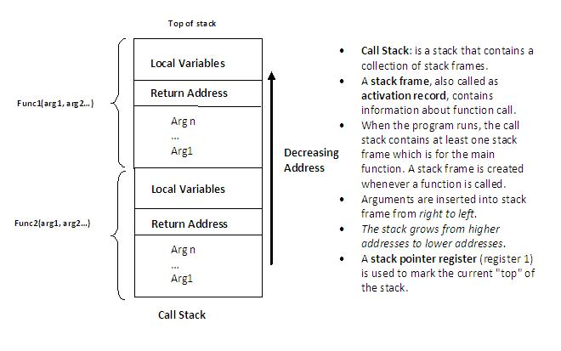
Call Stack / Activation Record

Slide 23
Integer Overflow
http://www.phrack.org/issues.html?issue=60&id=10
Since an integer is a fixed size (32 bits for the purposes of this paper), there is a fixed maximum value it can store. When an attempt is made to store a value greater than this maximum value it is known as an integer overflow.
Most compilers seem to ignore the overflow, resulting in an unexpected or erroneous result being stored.
This can get dangerous if the calculation has to do with the size of a buffer or how far into an array to index.
What happens then!!
  a = 0xffffffff
  b = 0x1
  r = a + b ➔ r = (0xffffffff + 0x1) % 0x100000000
  r = (0x100000000) % 0x100000000 = 0
  This is often called a "wrap around", as the result appears to wrap around to 0.

Slide 24
Integer Overflow Examples
Example 1
#include <stdio.h>
int main(void){
unsigned int num = 0xffffffff;
printf("num = %u (0x%x)\n", num, num);
printf("num + 1 = 0x%x\n", num + 1);
return 0;
}
/* EOF */
The output of this program looks like this:
num = 4294967295 (0xffffffff)
num + 1 = 0x0
Example 2
#include <stdio.h>
int main(void){
int n;
n = 0x7fffffff;
printf(“n = %d (0x%x)\n", n, n);
printf(“n + 1 = %d (0x%x)\n", n + 1 , n + 1);
return 0;
}
/* EOF */
The output of which is:
n = 2147483647 (0x7fffffff)
n + 1 = -2147483648 (0x80000000)

Slide 25
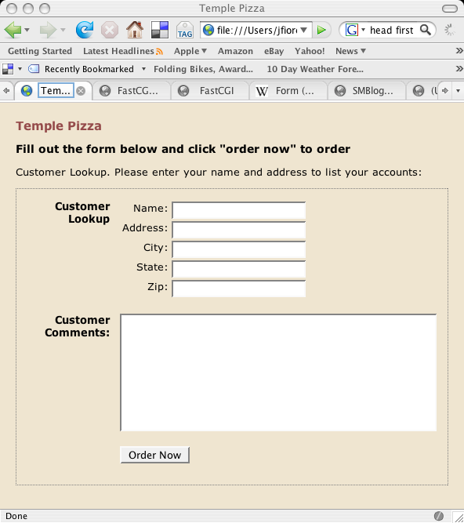

Incomplete Mediation (ex. SQL Injection)
John Fiore
SELECT * from CUSTOMERS
WHERE name = 'John Fiore'

Slide 26
Incomplete Mediation (ex. SQL Injection)
John Fiore' or '1'='1
SELECT * from CUSTOMERS
WHERE name = 'John Fiore'
OR '1'='1'

Slide 27
Bring examples on Cross-Site-Scripting (CSS)

Slide 28
Time-of-Check-to-Time-of-Use Errors(TOCTTOU)
Real Example:
  Buy something that costs $100
  The buyer removes five $20 bills from a wallet, carefully counts them in front of the seller, and lays them on the table
  Then the seller turns around to write a receipt
  While the seller's back is turned, the buyer takes back one $20 bill
  When the seller turns around, the buyer hands over the stack of bills, takes the receipt, and leaves
  Between the time the security was checked (counting the bills) and the access (exchanging the sculpture for the bills), a condition changed
    What was checked is no longer valid when the object (that is, the sculpture) is accessed

Slide 29
Time-of-Check-to-Time-of-Use Errors(TOCTTOU)
Computing Example:
  “file” is a symbolic link for a file that can be opened normally
  The attacker, after access is called, can change the “file”
The program with TOCTTOU vulnerability | Attacker
if (access("file", W_OK) != 0) { exit(1); } //writing over /etc/passwd fd = open("file",O_WRONLY); write(fd, buffer, sizeof(buffer)); | // After the access check // and Before the open, "file" points to the password database symlink("/etc/passwd", "file");

Slide 30
Viruses and Other Malicious Code
Much of the work done by a program is invisible to users who are not likely to be aware of any malicious activity
Can you tell
  if a game program does anything in addition to its expected interaction with you?
  Which files are modified by a word processor when you create a document?
  Which programs execute when you start your computer or open a web page?
Most users cannot answer these questions

Slide 31
Malicious Code
None of us like the unexpected, especially in our programs
  Malicious code behaves in unexpected ways
    thanks to a malicious programmer's intention
Malicious code can do anything any other program can
  writing a message on a computer screen, stopping a running program, generating a sound, or erasing a stored file.
  Or malicious code can do nothing at all right now; it can be planted to lie dormant, undetected, until some event triggers the code to act (e.g., based on time)

Slide 32
Malicious Code
malicious code is still around, and its effects are more pervasive
  What it looks like and how it works?
  How can malicious code take control of a system?
  How can it lodge in a system?
  How does malicious code spread?
  How can it be recognized?
  How can it be detected?
  How can it be stopped?
  How can it be prevented?

Slide 33
Kinds of Malicious Code
Code Type | Characteristics
Virus | Attaches itself to program and propagates copies of itself to other programs
Worm | Propagates copies of itself through a network
Trojan horse | Looks legal/normal programs, but contains unexpected, additional functionality
Logic bomb | Triggers action when condition occurs
Time bomb | Triggers action when specified time occurs
Trapdoor/backdoor | Allows unauthorized access to functionality
Rabbit | Replicates itself without limit to exhaust resources

Slide 34
General Exploit Timeline
The general exploit timeline/scenario follows this sequence:
  An attacker discovers a previously unknown vulnerability.
  The manufacturer becomes aware of the vulnerability.
  Someone develops code (called proof of concept) to demonstrate the vulnerability in a controlled setting.
  The manufacturer develops and distributes a patch or work-around that counters the vulnerability.
  Users implement the control.
  Someone extends the proof of concept, or the original vulnerability definition, to an actual attack.
As long as users receive and implement the control before the actual attack, no harm occurs.
An attack before availability of the control is called a zero day exploit.

Slide 35
How Viruses Attach
For a virus to do its malicious work and spread itself, it must be activated by being executed
  Many ways to ensure that programs will be executed
  E.g., the SETUP program call dozens or hundreds of other programs
    If any one of these programs contains a virus, the virus code could be activated
  Running an infected program obtained from distribution medium, such as a CD, or opening an e-mail attachment are common way for viruses to get activated.
    Also, objects such as graphics or photo images can contain code to be executed by an editor/viewer
  it is a bad idea for programs to perform potentially security-relevant actions without a user's consent
    However, ease-of-use often trumps security, so programs such as browsers, e-mail handlers, and viewers often "helpfully" open files without asking the user first

Slide 36
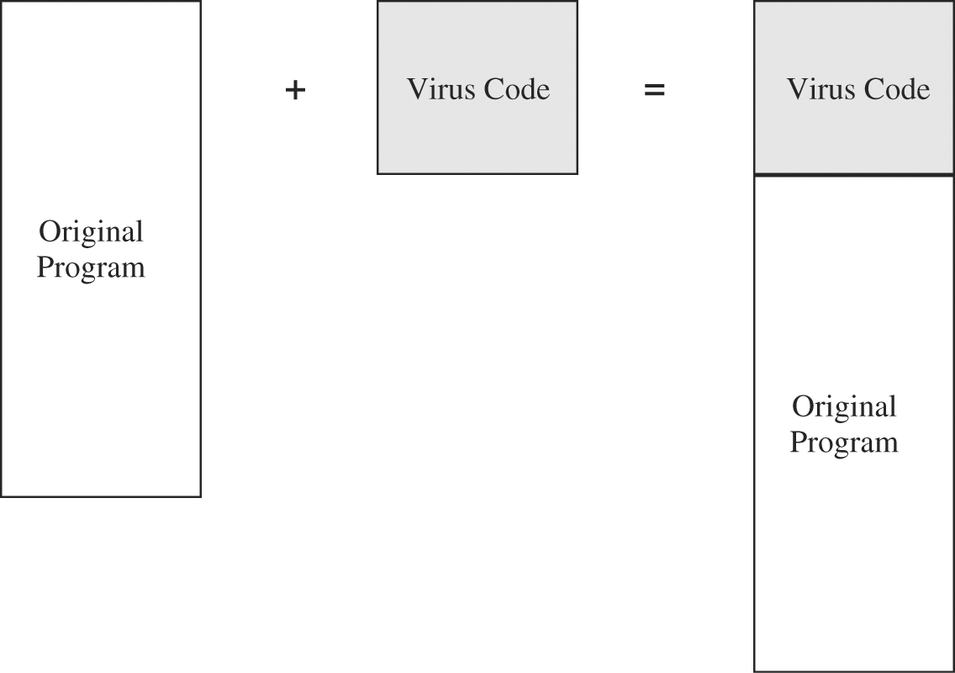
Appended Viruses
A program virus attaches itself to a program; then, whenever the program is run, the virus is activated.

Slide 37
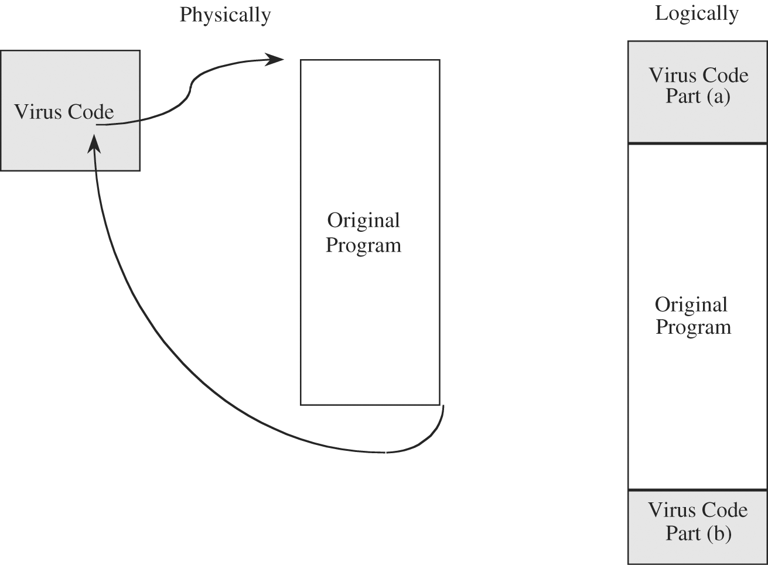
Appended Viruses
An alternative to the attachment is a virus that runs the original program but has control before and after its execution
Virus Surrounding a Program.

Slide 38
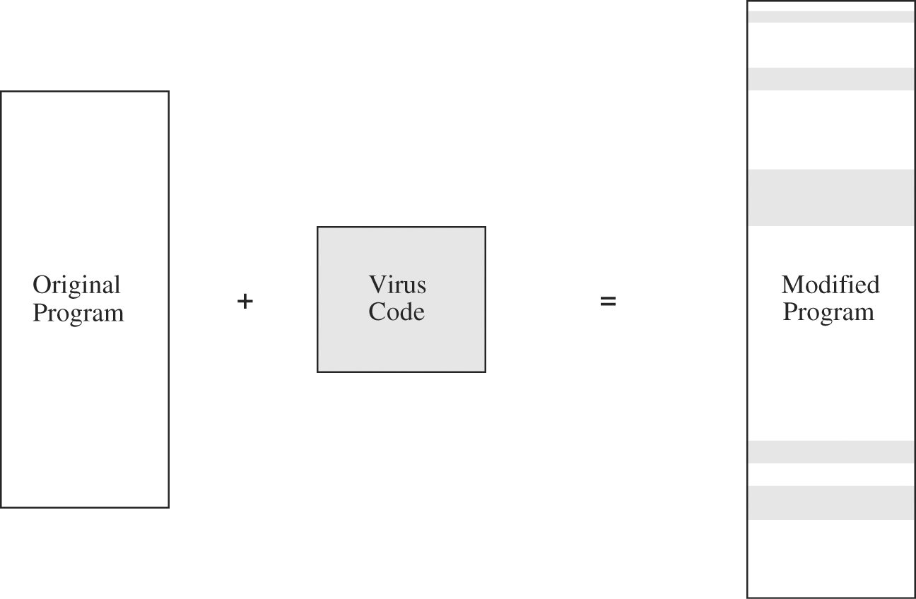
Appended Viruses
A third situation occurs when the virus replaces some of its target, integrating itself into the original code of the target.
Virus Integrated into a Program

Slide 39
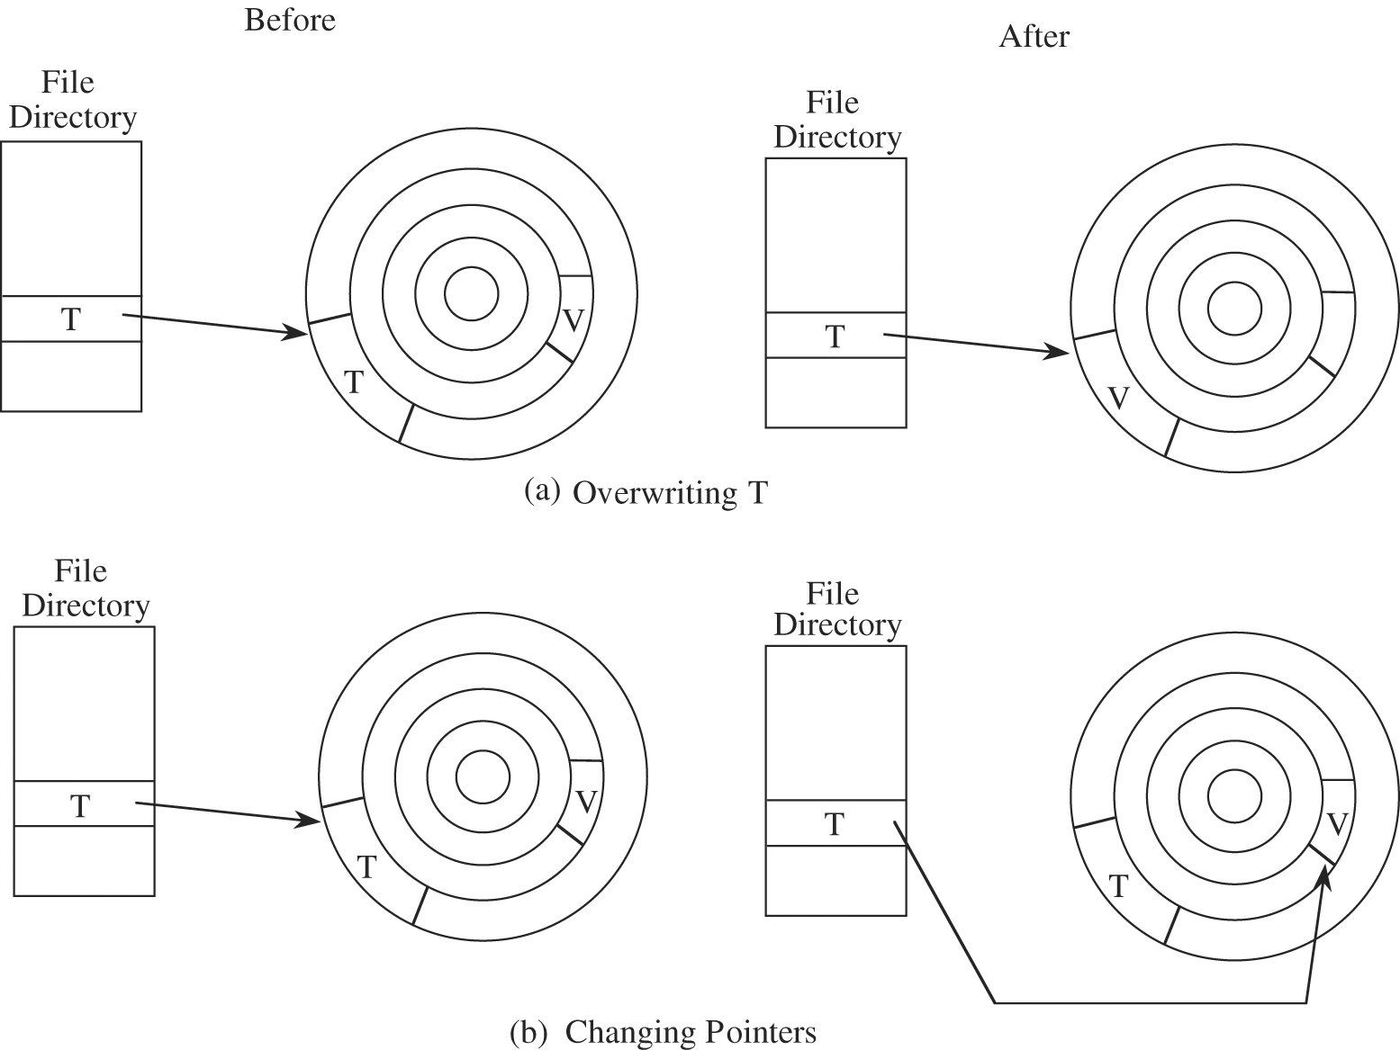
Virus Completely Replacing a Program

Slide 40
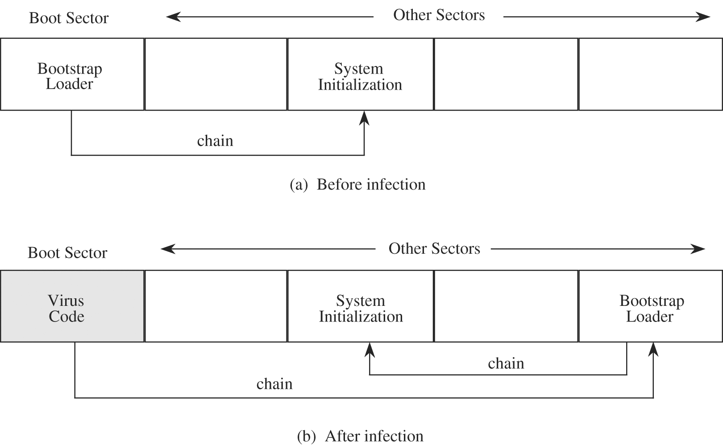
Boot Sector Viruses

Slide 41
Memory-Resident Viruses
Some parts of the operating system and most user programs execute, terminate, and disappear
  For very frequently used parts of the operating system and for a few specialized user programs, it would take too long to reload the program each time it was needed
    Such code remains in memory and is called "resident" code
    E.g., a routine that interprets keys pressed on the keyboard
  Virus writers like to attach viruses to resident code
  A virus can also modify the operating system's table of programs to run
  E.g., changing the startup programs from Windows registry so the virus starts every boot
Also, viruses like application programs (such as MS word) and frequently used libraries

Slide 42
Virus Signatures
The pattern which distinguishes a virus is called a signature.
  Anti-viruses (or called virus scanners) look for signatures to identify a virus
  The signature is part of the virus code

Slide 43
Hard-to-Find Viruses
Properties
  It is hard to detect.
  It is not easily destroyed or deactivated.
  It spreads infection widely.
  It can reinfect its home program or other programs.
  It is easy to create.
  It is machine independent and operating system independent.
Few viruses meet all these criteria. The virus writer chooses from these objectives when deciding what the virus will do and where it will reside.

Slide 44
Polymorphic Viruses
A virus that can change its appearance is called a polymorphic virus. (Poly means "many" and morph means "form.")

Slide 45
Prevention of Virus Infection
several techniques for building a reasonably safe community
  Use only commercial software acquired from reliable, well-established vendors
  Use virus detectors (often called virus scanners) regularly and update them daily
  Open attachments only when you know them to be safe
  Make a recoverable system image and store it safely
  Make and retain backup copies of executable system files
  Test all new software on an isolated computer

Slide 46
The Brain Virus
One of the earliest viruses
one of the most intensively studied
was given its name because it changes the label of any disk it attacks to the word "BRAIN."
originated in Pakistan
attacks PCs running an old Microsoft operating system
The Brain virus positions itself in the boot sector and in six other sectors of the disk
The Brain virus appears to have no effect other than passing its infection

Slide 47
The Internet Worm
2 November 1988
caused serious damage to the network
The perpetrator was Robert T. Morris, Jr., a graduate student at Cornell University
  He was convicted in 1990 of violating the 1986 Computer Fraud and Abuse Act. He received a fine of $10,000, a three-year suspended jail sentence, and was required to perform 400 hours of community service
Morris programmed the Internet worm to accomplish three main objectives:
  Determine where it could spread to.
  Spread its infection.
  Remain undiscovered and undiscoverable.

Slide 48
The Internet Worm
The worm exploited several known flaws and configuration failures of Berkeley version 4 of the Unix operating system
The worm's primary effect was resource exhaustion
  Many copies of the worm, all busily attempting to spread the infection
A second-order effect was the disconnection of many systems from the Internet
third-order effect: isolation and inability to perform necessary work
The worm caused an estimated 6,000 installations to shut down or disconnect from the Internet
cost of the damage range from $100,000 to $97 million.

Slide 49
Code Red
appeared in the middle of 2001
propagates itself on web servers running Microsoft's Internet Information Server (IIS) software
infected more than 250,000 systems in just nine hours
This spread has the potential to disrupt business and personal use of the Internet for applications such as e-commerce, e-mail and entertainment
the Code Red worm struck faster than any other worm in Internet history
overall, 750,000 servers were affected, including 400,000 just in the period from August 1 to 10
Code Red's damage was expected to exceed $2 billion

Slide 50
Keystroke Logging
First, recognize that there is not a direct path between a key you press on your keyboard and the program (let's say a word processor) that handles that keystroke.
  When you press A
    it activates a switch that generates a signal that is received by a device driver, converted and analyzed and passed along, until finally your word processor receives the A
    there is still more conversion, analysis, and transmission until the A appears on your screen
A malicious program called a keystroke logger retains a surreptitious copy of all keys pressed

Slide 51
Man-in-the-Middle Attacks
A keystroke logger is a special form of the more general man-in-the-middle attack
malicious program interjects itself between two other programs
One example of a man-in-the-middle attack could be a program that operated between your word processor and the file system
  each time you thought you were saving your file, the middle program prevented that, or scrambled your text or encrypted your file

Slide 52
Controls Against Program Threats
development controls
  limit software development activities, making it harder for a developer to create malicious (or inadvertent) programs
  produce better software
operating system controls
  limit access to computing system objects and provides safe sharing of information among programs
administrative controls
  limit the kinds of actions people can take
  improve system usability, reusability, and maintainability

